Slide 1
Speaker Modelling
ETLYAK
Notes:
Jonas
1

Slide 2
Description
Goals
Predict
Compare
Methods
Analogies
Matlab
Measurements
Notes:
Jonas
2

Slide 3
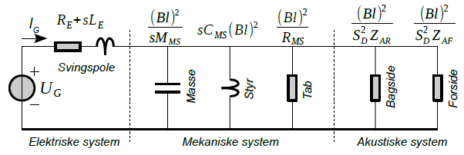


Analysis
Thiele/Small
Electrical, mechanical, acoustical
Transfer Functions
2. order HP
Drive Unit
Infinite enclosure
Cross-over filter
Bass reflex
Notes:
Jonas
3

Slide 4
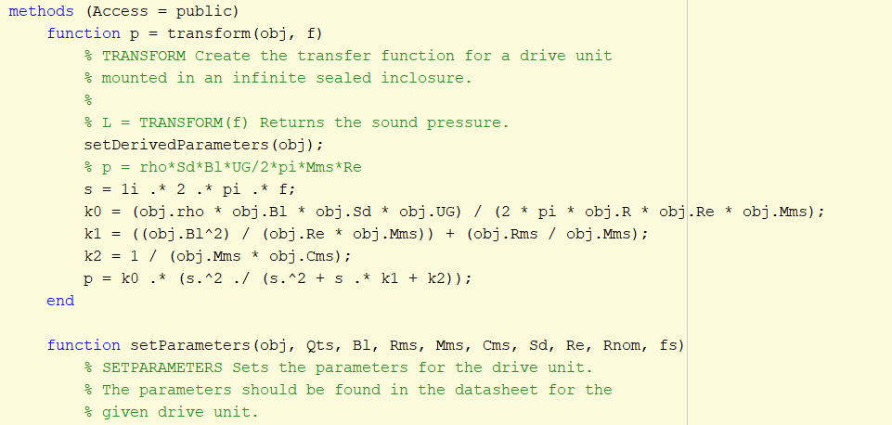
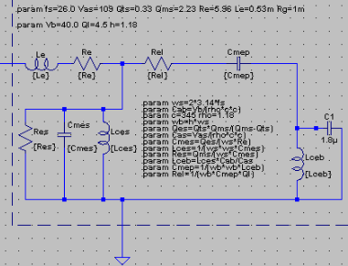
Design
Matlab vs. Spice
Why Classes?
Notes:
Lasse
4

Slide 5
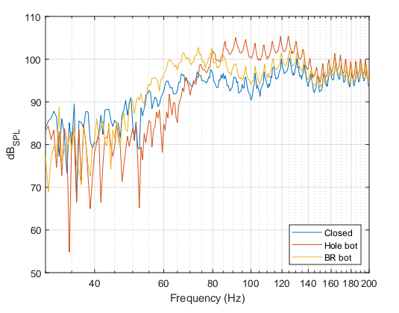
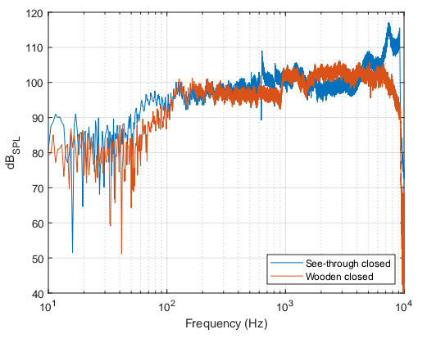
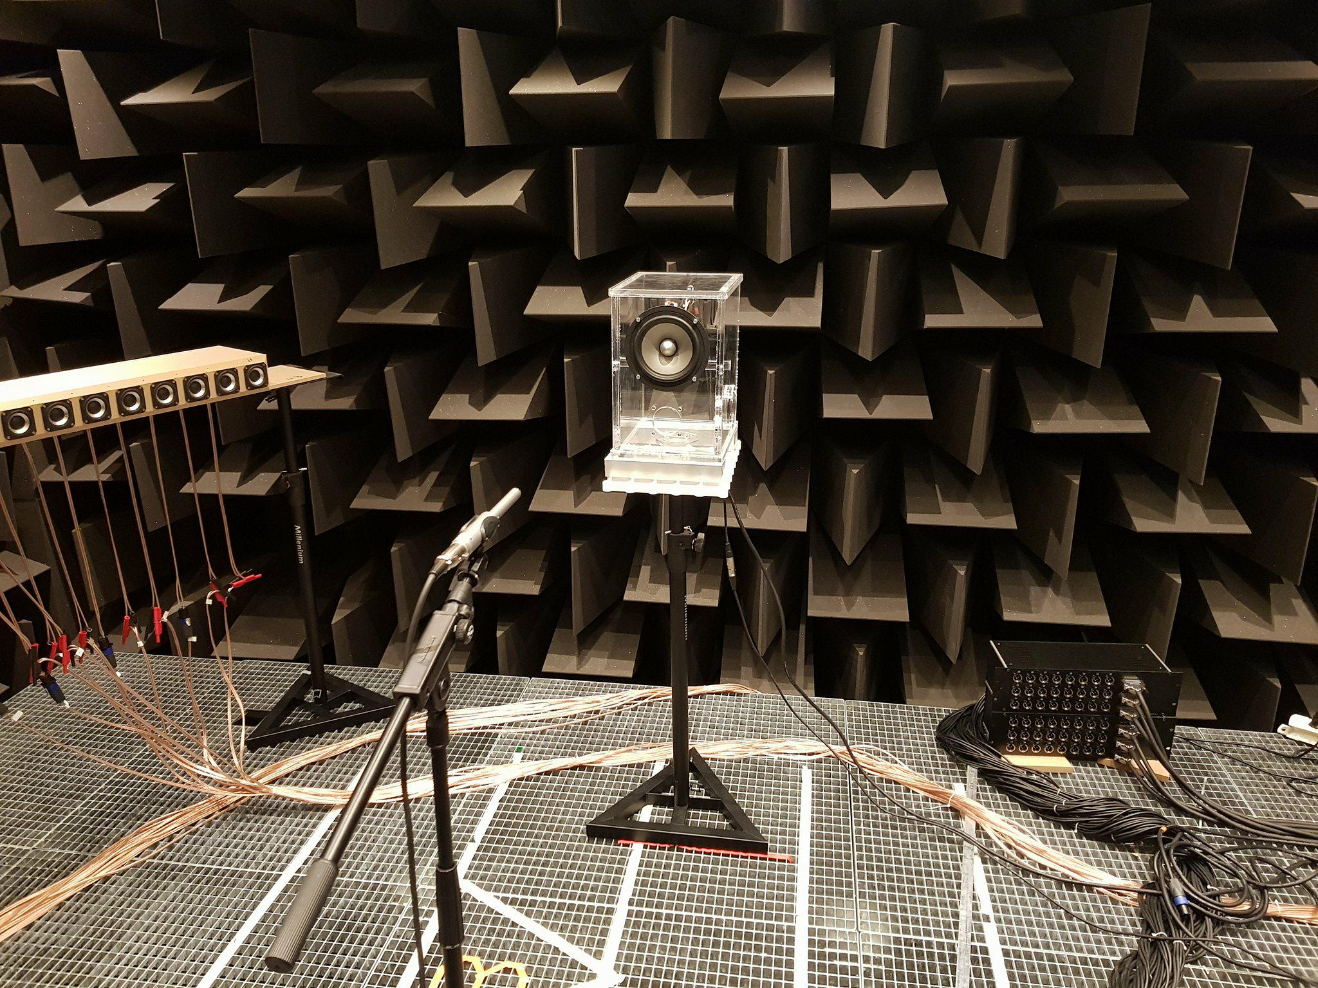
Measurement Setup
Equipment
Reflection on results
Notes:
Lasse
5

Slide 6
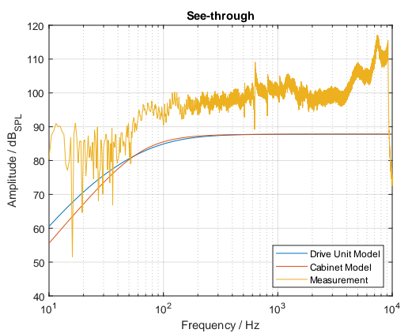
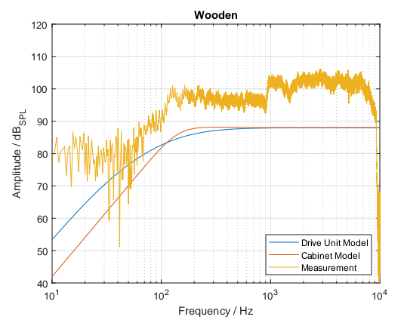
Results
Comparison of model and measurements
Notes:
Lasse
6

